Slide 1
TEXT SUMMARIZATION USING N-GRAMS
For better comprehension and efficiency

Slide 2
INTRODUCTION
Importance of Text Summarization
Context: In today’s information-rich environment, efficiently summarizing large volumes of text is crucial for quick understanding and decision-making.
Need: Helps in managing data overload and enhances comprehension.
Project Objective
Goal: Develop an advanced text summarization algorithm.
Method: Utilize N-gram frequency analysis to identify and extract the most significant sentences.
Relevance and Benefits
Challenges Addressed: Overcome limitations of traditional summarization methods in handling large and diverse text corpora.
Expected Outcome: Provides concise, meaningful summaries that reflect the core ideas of the original text, improving readability and information processing.
Scope
Focus: Implementation of a basic yet effective summarization technique based on statistical analysis of N-grams.

Slide 3
PROBLEM STATEMENT
Problem Overview
Information Overload: With the exponential growth of digital content, efficiently processing and summarizing large amounts of text has become increasingly challenging.
Existing Methods: Traditional summarization techniques often struggle with maintaining relevance and coherence in diverse text datasets.
Project Goals
Automated Summarization: Develop an algorithm to automatically generate summaries from large text Accuracy and Efficiency: Ensure the summarization algorithm is both accurate in capturing the main ideas and efficient in processing text data.
Challenges Addressed
Relevance: Improve the relevance of the extracted summaries by focusing on the frequency of N-grams.
Coherence: Maintain coherence and readability in the generated summaries despite the complexity of the original text.
Significance
Impact: The project aims to provide a tool that enhances information management and comprehension, benefiting various applications from academic research to content curation.

Slide 4
TOOLS AND APPLICATIONS
Programming Language
Python: Chosen for its extensive libraries and ease of use in text processing and data analysis.
Libraries and Frameworks
NLTK (Natural Language Toolkit): Used for text preprocessing, tokenization, and other NLP tasks.
Scikit-learn: Utilized for calculating N-gram frequencies and implementing statistical methods.
Data
Sample Text Corpora: Publicly available datasets used for training and evaluating the summarization algorithm.
Sources: Text datasets from various domains to ensure robustness and generalizability of the algorithm.
Development Environment
IDE: Jupyter Notebook or any preferred Python IDE for development and testing.
Version Control: Git for version control and collaboration.

Slide 5
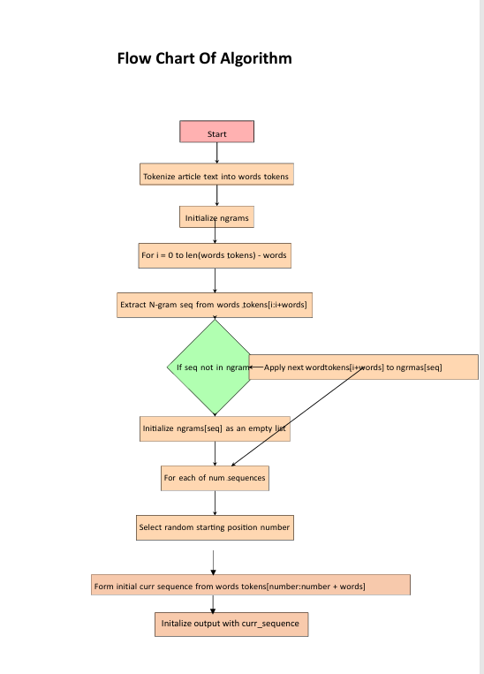
PROJECT DESIGN

Slide 6
DETAILED DESCRIPTION OF SUB MODULES
Text Preprocessing
Objective: Prepare the raw text data for analysis.
Tasks:
Tokenization: Splits text into smaller units (words or phrases) to facilitate analysis.
Stop-word Removal: Eliminates common words (e.g., "the," "and") that do not contribute significant meaning.
Stemming/Lemmatization: Reduces words to their root forms (e.g., "running" to "run") to normalize the text and improve accuracy.
N-gram Analysis
Objective: Analyze the frequency of N-grams to determine important phrases within the text.
Tasks:
Bigram/Trigram Calculation: Computes the frequency of two-word (bigrams) or three-word (trigrams) combinations.
Frequency Counting: Uses statistical methods to count and rank the most common N-grams.
Sentence Scoring
Objective: Evaluate and score sentences based on the N-grams they contain.
Tasks:
Score Assignment: Assign scores to sentences based on the frequency and significance of the N-grams present.
Ranking: Rank sentences according to their scores to determine which are most important.
Summary Generation
Objective: Create a coherent summary by selecting the most important sentences.
Tasks:
Top Sentence Selection: Extract sentences with the highest scores to form the summary.
Coherence Check: Ensure that the selected sentences form a logical and readable summary.
Evaluation
Objective: Assess the performance and quality of the summarization algorithm.
Tasks:
Testing: Evaluate the algorithm with different text datasets to ensure robustness.
Refinement: Make adjustments based on performance metrics and feedback to improve accuracy and coherence.

Slide 7
EXPECTED OUTPUT
CONCLUSION OF THE PROJECT
Goal Achieved: Development of a functional text summarization algorithm.
Effectiveness: The algorithm aims to provide clear, concise summaries from large text datasets.
Expected Outcomes
High-Quality Summaries: Summaries that accurately capture the main ideas of the original text.
Improved Comprehension: Enhanced readability and understanding of complex text data.
Efficiency: Efficient processing of large volumes of text, saving time and resources.
Applications
Academic Research: Assisting researchers in quickly grasping relevant literature.
Content Management: Streamlining content curation and management in digital platforms.
Information Retrieval: Enhancing search and retrieval systems by summarizing relevant information.
Performance Metrics
Accuracy: Measurement of how well the generated summaries reflect the key points of the original text.
Readability: Evaluation of how easy the summaries are to read and understand.
Processing Speed: Assessment of the algorithm's efficiency in handling large text corpora.

Slide 8
Performance Summary
Effectiveness: Summaries accurately capture key points from the original text.
Quality: Coherent and relevant summaries.
Evaluation Metrics
Accuracy: Measures how well summaries reflect the main ideas.
Readability: Assesses ease of understanding.
Processing Speed: Time taken to summarize text.
Challenges
Data Variability: Handling different text formats.
Algorithm Limitations: Addressing accuracy and coherence issues.
Refinement
Feedback Integration: Used feedback to enhance the algorithm.
Optimization: Improved performance based on test results.
EXPECTED OUTPUT

Slide 9
FUTURE WORK
Improvements and Extensions
Algorithm Enhancements:
Accuracy: Refine algorithms to better capture context and nuances.
Readability: Improve summarization techniques for more natural summaries.
Additional Features:
Customizable Summarization: Allow users to adjust summary length and focus.
Multi-Language Support: Extend capabilities to handle texts in different languages.
Future Research Directions
Advanced Techniques: Explore integration with machine learning models like transformers for better performance.
User Feedback: Conduct more extensive user studies to gather feedback and make iterative improvements.
Potential Applications
New Domains: Apply the summarization algorithm to new areas, such as legal documents or medical records.
Scalability: Enhance the system to handle even larger datasets and more complex text structures.

Slide 10
BASIC Q&A
How does the N-gram frequency analysis work?
Answer: N-gram frequency analysis identifies and counts sequences of N words (e.g., bigrams or trigrams) in a text to determine the most common phrases. These frequencies are then used to score and rank sentences for summarization.
What are the main challenges of this summarization approach?
Answer: Key challenges include managing data variability, ensuring coherence in the summary, and addressing the limitations of frequency-based scoring which might miss nuanced context or meaning.
How does the algorithm handle different types of text?
Answer: The algorithm is designed to preprocess and analyze various text types by standardizing text through tokenization, stop-word removal, and stemming, making it adaptable to different formats and domains.
What metrics are used to evaluate the performance of the summarization algorithm?
Answer: Performance is evaluated based on accuracy (how well the summary reflects the main ideas), readability (ease of understanding), and processing speed (time taken to generate the summary).
Can the algorithm be applied to other languages or domains?
Answer: Currently, the algorithm is focused on English text, but future work includes extending capabilities to support multiple languages and specialized domains.

Slide 11
BASIC Q&A
How does the N-gram frequency analysis work?
Answer: N-gram frequency analysis identifies and counts sequences of N words (e.g., bigrams or trigrams) in a text to determine the most common phrases. These frequencies are then used to score and rank sentences for summarization.
What are the main challenges of this summarization approach?
Answer: Key challenges include managing data variability, ensuring coherence in the summary, and addressing the limitations of frequency-based scoring which might miss nuanced context or meaning.
How does the algorithm handle different types of text?
Answer: The algorithm is designed to preprocess and analyze various text types by standardizing text through tokenization, stop-word removal, and stemming, making it adaptable to different formats and domains.
What metrics are used to evaluate the performance of the summarization algorithm?
Answer: Performance is evaluated based on accuracy (how well the summary reflects the main ideas), readability (ease of understanding), and processing speed (time taken to generate the summary).
Can the algorithm be applied to other languages or domains?
Answer: Currently, the algorithm is focused on English text, but future work includes extending capabilities to support multiple languages and specialized domains.

Slide 12
THANK YOU

